Slide 1
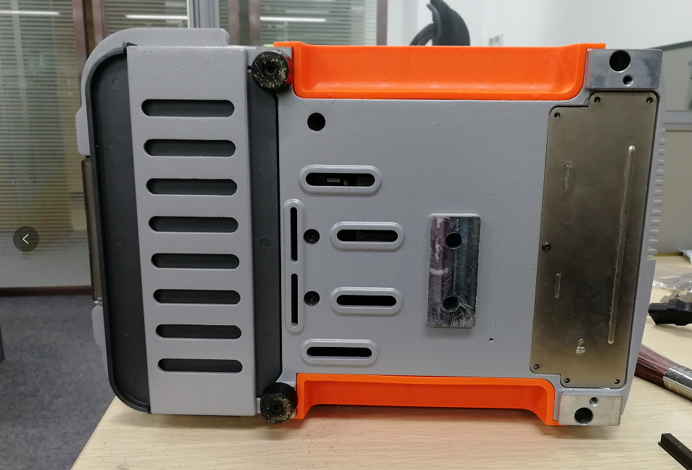
Put down the machine and take out those screws like picture show

Slide 2
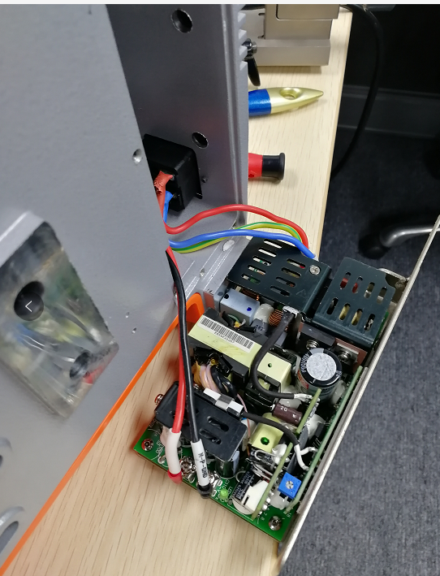
Take out that power board and check the output voltage if it’s 24V in the position like picture show ( mark with circle) , if not ,check the input voltage ( mark in arrow ) if has 110/220 V ,if input voltage is normal ,which means the power board is damage ,

